Slide 1
Computer Memory
Lecture # 3
And its types

Slide 2
A computer is an electronic device and that accepts data, processes on that data, and gives the desired output. It performs programmed computation with accuracy and speed. Or in other words, the computer takes data as input and stores the data/instructions in the memory (use them when required). After processes the data, it converts into information. Finally, gives the output.

Slide 3
What is it?
Computer memory, device that is used to store data or programs (sequences of instructions) on a temporary or permanent basis for use in an electronic digital computer.
Computers represent information in binary code, written as sequences of 0s and 1s. Each binary digit (or “bit”) may be stored by any physical system that can be in either of two stable states, to represent 0 and 1. Such a system is called bistable.
This could be an on-off switch, an electrical capacitor that can store or lose a charge, a magnet with its polarity up or down, or a surface that can have a pit or not.
Today capacitors and transistors, functioning as tiny electrical switches, are used for temporary storage, and either disks or tape with a magnetic coating, or plastic discs with patterns of pits are used for long-term storage.

Slide 4
How does computer memory work?
When a program is open, it is loaded from secondary memory to primary memory.
Because there are different types of memory and storage, an example of this could be a program being moved from a solid-state drive (SSD) to RAM.
Because primary storage is accessed faster, the opened program will be able to communicate with the computer's processor at quicker speeds.

Slide 5
Many Types
There are many types of computer memory, an umbrella term for data storage technology built into or externally connected to a computer device or server.
Some are designed to be fast—the central processing unit (CPU) can access data stored there quickly—while others are designed to be low cost, so large amounts of data can be stored economically.
All computer memory types fall into one of two categories, primary or secondary, depending upon their purpose and use case.

Slide 6
Two categories
Primary Memory/ Main Memory vs Secondary Memory/Auxiliary Memory
Internal Memory vs External Memory
Memory vs Storage

Slide 7
Primary and Secondary
There are technically two types of computer memory: Primary and Secondary.
Memory vs. Storage:
The term memory is used as a synonym for primary memory or as an abbreviation for a specific type of primary memory called random access memory (RAM).
Memory is the electronic holding place for the instructions and data a computer needs to reach quickly. It's where information is stored for immediate use. This type of memory is located on microchips that are physically close to a computer's microprocessor.
It enables CPU to access data that is stored for a short time i.e. primary memory is volatile, meaning it isn't retained when the computer is turned off.
Term storage is some times used for secondary memory.
The term storage refers to secondary memory and is where data in a computer is kept. An example of storage is a hard drive or a hard disk drive (HDD). Storage is nonvolatile, meaning the information is still there after the computer is turned off and then back on.
If a computer's central processer (CPU) had to only use a secondary storage device, computers would become much slower. In general, the more memory (primary memory) a computing device has, the less frequently the computer must access instructions and data from slower (secondary) forms of storage.

Slide 8
Memory vs. storage Contd…
A running program may be in a computer's primary memory when in use -- for fast retrieval of information -- but when that program is closed, it resides in secondary memory or storage.
How much space is available in memory and storage differs as well. In general, a computer will have more storage space than memory. For example, a laptop may have 8 GB of RAM while having 250 GB of storage. The difference in space is there because a computer will not need fast access to all the information stored on it at once, so allocating approximately 8 GB of space to run programs will suffice.

Slide 9
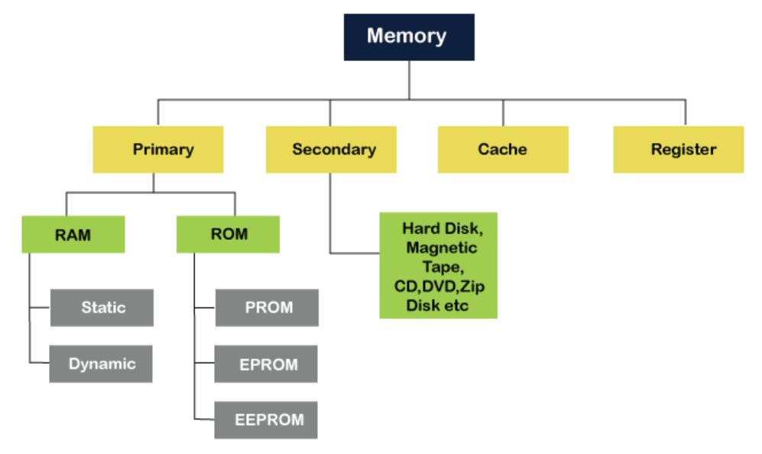

Slide 10
Types of computer memory
In general, memory can be divided into primary and secondary memory; moreover, there are numerous types of memory when discussing just primary memory. Some types of primary memory include the following
Note: Here we mean Internal Memories, Primary Memories, Memories that CPU can access directly.

Slide 11
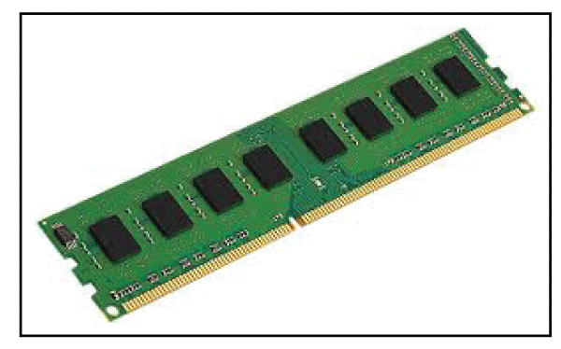
RAM

Slide 12
Primary Memory Types
It is also known as the main memory of the computer system
It is used to store data and programs or instructions during computer operations
Primary memory is the segment of computer memory that can be accessed directly for rapid processing and for quicker booting.
It’s usually placed in close physical proximity to the CPU in order to minimize communication times.
It uses semiconductor technology and hence is commonly called semiconductor memory.
Examples of primary memory types include random access memory (RAM) and read only memory (ROM).
Both RAM and ROM are used to store data for direct access by the CPU.
RAM is volatile, meaning its data is deleted once the system has been powered down.
ROM is non-volatile, meaning it keeps its data after the system has been powered down.

Slide 13
RAM (Random Access Memory)
It is a volatile memory. Volatile memory stores information based on the power supply.
If the power supply fails/ interrupted/stopped, all the data and information on this memory will be lost. RAM is used for booting up or start the computer. It temporarily stores programs/data which has to be executed by the processor.
Types of RAM
RAM is of two types:
Static RAM (SRAM)
Dynamic RAM (DRAM)

Slide 14
S RAM (Static RAM)
S RAM uses transistors and the circuits of this memory are capable of retaining their state as long as the power is applied.
This memory consists of the number of flip flops with each flip flop storing 1 bit.
It has less access time and hence, it is faster.
SRAM: SRMA (Static Random-Access Memory) is a type of RAM used to store static data in the memory. It means to store data in SRAM remains active as long as the computer system has a power supply. However, data is lost in SRAM when power failures have occurred.
Characteristics of Static Ram
It does not require to refresh.
It is faster than DRAM
It is expensive.
High power consumption
Longer life
Large size
Uses as a cache memory

Slide 15
D RAM (Dynamic RAM)
D RAM uses capacitors and transistors and stores the data as a charge on the capacitors.
They contain thousands of memory cells. It needs refreshing of charge on capacitor after a few milliseconds.
Characteristics of DRAM
It requires continuously refreshed to retain the data.
It is slower than SRAM
It holds a large amount of data
It is the combination of capacitor and transistor
It is less expensive as compared to SRAM

Slide 16
SRAM vs DRAM
SRAM Vs. DRAM
SRAM | DRAM
It is a Static Random-Access Memory. | It is a Dynamic Random Access Memory.
The access time of SRAM is slow. | The access time of DRAM is high.
It uses flip-flops to store each bit of information. | It uses a capacitor to store each bit of information.
It does not require periodic refreshing to preserve the information. | It requires periodically refreshing to preserve the information.
It uses in cache memory. | It is used in the main memory.
The cost of SRAM is expensive. | The cost of DRAM is less expensive.
It has a complex structure. | Its structure is simple.
It requires low power consumption. | It requires more power consumption.

Slide 17
ROM (Read Only Memory)
ROM gets its name because data stored on it is immutable—it cannot be removed or changed using ordinary methods. As its name refers to read-only memory, we can only read the programs and data that is stored on it
Like RAM, it’s an incredibly fast type of computer memory that can be found in close proximity to the device’s CPU. But unlike RAM, ROM is non-volatile —it doesn’t lose its data when power is cut off—which it has in common with secondary memory.
ROM is used to store information that is used to operate the system. When a device is turned on, or booted, the first thing the CPU reads is Instructions on the ROM, which usually contains “bootstrap code” that allows the computer to carry out the necessary steps for launching the operating system on the secondary memory.
It contains some electronic fuses that can be programmed for a piece of specific information. The information stored in the ROM in binary format. It is also known as permanent memory.
There are three main types of ROM that can be found in all types of electronic devices, from game consoles to car radios and navigation systems.

Slide 18
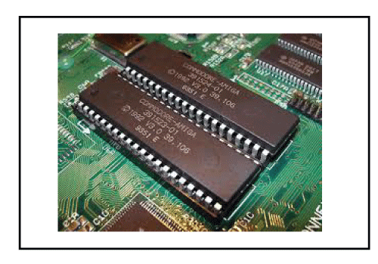
ROM

Slide 19
Types of rom
Masked Read-Only Memory (MROM)
The very first read-only memories, or ROMs, were physical devices that held a data or instruction set that had been pre-programmed.
This type of ROM is known as a "masked ROM," and it is a more affordable option than other kinds of ROM.

Slide 20
Types of rom
PROM (Programmable Read Only Memory):
PROM is different from true ROM in that it is manufactured in its empty state instead of sold and distributed with instructions already programmed on it. PROM can be programmed after the fact using a PROM programmer or burner.
This read-only memory is modifiable once by the user.
The user purchases a blank PROM and uses a PROM program to put the required contents into the PROM.
Its content can’t be erased once written.

Slide 21
Types of rom
EPROM (Erasable Programmable Read Only Memory):
The information stored on EPROM can be erased and then reprogrammed.
This can only be done by taking it out of the device and exposing it to ultraviolet light to erase it before burning new data to it.
EPROM is an extension to PROM where you can erase the content of ROM by exposing it to Ultraviolet rays for nearly 40 minutes. EPROM is programmable read-only memory PROM that can be erased and re-used.
Erasure is caused by shining an intense ultraviolet light through a window designed into the memory chip.

Slide 22
Types of rom
EEPROM (Electrically Erasable Programmable Read Only Memory):
EEPROM differs from both PROM and EPROM by not needing to be taken out to erase and reprogram.
While the reformatting process can be slow, it’s not done often and usually only to update critical code such as firmware or BIOS.
Here the written contents can be erased electrically.
You can delete and reprogramme EEPROM up to 10,000 times.
Erasing and programming take very little time, i.e., nearly 4 -10 ms(milliseconds).
Any area in an EEPROM can be wiped and programmed selectively.

Slide 23
Types of rom
Flash ROM:
Flash memory is a non-volatile storage memory chip that can be written or programmed in small units called Block or Sector. Flash Memory is an EEPROM form of computer memory, and the contents or data cannot be lost when the power source is turned off. It is also used to transfer data between the computer and digital devices.

Slide 24
RAM | ROM
It is a Random-Access Memory. | It is a Read Only Memory.
Read and write operations can be performed. | Only Read operation can be performed.
Data can be lost in volatile memory when the power supply is turned off. | Data cannot be lost in non-volatile memory when the power supply is turned off.
It is a faster and expensive memory. | It is a slower and less expensive memory.
Storage data requires to be refreshed in RAM. | Storage data does not need to be refreshed in ROM.
The size of the chip is bigger than the ROM chip to store the data. | The size of the chip is smaller than the RAM chip to store the same amount of data.
Types of RAM: DRAM and SRAM | Types of ROM: MROM, PROM, EPROM, EEPROM

Slide 25
 | RAM | ROM
Stands for | Random-access memory | Read-only memory
Storage volatility | Volatile | Non-volatile
Storage capacity | Up to 256GB per chip | up to 8GB per chip
Speed | Faster | Slower
Use | In standard computing operations | During the boot process
Types | DRAM, SRAM | PROM, EPROM, EEPROM
Cost | Higher | Lower
Chip size | Larger | Smaller

Slide 26
Secondary Memory
It is also known as auxiliary memory and backup memory.
It is a non-volatile memory and used to store a large amount of data or information.
The data or information stored in secondary memory is permanent, and it is slower than primary memory.
A CPU cannot access secondary memory directly.
The data/information from the auxiliary memory is first transferred to the main memory, and then the CPU can access it.
In secondary memory, data is stored permanently even when the power is off.
Secondary memory is the persistent, non-volatile segment of computer memory not directly accessed by the CPU. It’s designed for more affordable long-term storage of large amounts of data. Examples include hard disk drives (HDDs), solid state drives (SSDs), cloud storage, and tape drives, to name a few.
Secondary memory tends to be more affordable than primary memory, and is available with much greater capacities. The different types of secondary memory enable users to store personal data and information along with software, applications, and services that can be accessed indirectly by the computer’s CPU through its RAM.

Slide 27
Characteristics/ Features of Secondary Memory
Its speed is slower than the primary/ main memory.
Store data cannot be lost due to non-volatile nature.
It can store large collections of different types, such as audio, video, pictures, text, software, etc.
All the stored data in a secondary memory cannot be lost because it is a permanent storage area; even the power is turned off.
It has various optical and magnetic memories to store data.
It is a slow memory but reusable.
It is a reliable and non-volatile memory.
It is cheaper than primary memory.
The storage capacity of secondary memory is large.
A computer system can run without secondary memory.

Slide 28
Hard Disk Drives (HDDs)
Hard disk drives are electro-mechanical data storage devices capable of keeping and restoring data over a long period of time.
They’re built from a stack of rotating disks held in place by spindles.
HDDs are the cheapest option per gigabyte compared to other long-term secondary storage, but they’re less durable.
HDDs have many moving parts, all of which have their own possible points of error.
They’re also noisy, consume a lot of power, and can be slower to access and write compared to the speed of the average RAM.
That said, HDDs are great for long-term storage and archiving. They’re often found in older and more budget-friendly desktop computers and laptops.

Slide 29
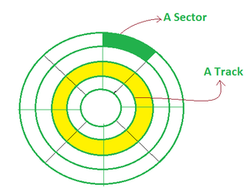
Hard Disk Drives (HDDs)
A magnetic disk is a circular metal or a plastic plate and these plates are coated with magnetic material. The disc is used on both sides.
Bits are stored in magnetized surfaces in locations called tracks that run in concentric rings. Sectors are typically used to break tracks into pieces.
Hard discs are discs that are permanently attached and cannot be removed by a single user.

Slide 30
Solid State Drives
Solid-state drives are a type of semiconductor-based long-term, non-volatile storage.
They use NAND flash memory in persistent data storage and are typically used as secondary storage in a computer to hold personal files.
SSDs use flash memory to keep data in an integrated circuit.
Data on an SSD can be written, read, duplicated, and transferred electronically without making noise or requiring movement.
Without the mechanical parts found in their HDD counterparts, SSDs are capable of operating silently and efficiently with minimal chances of physical damage.
While they aren’t as durable, they can last up to five years, which means they aren’t as effective for archival and long-term storage.
They’re faster and more compact than HDDs, but considerably more expensive and tend to be smaller in capacity.

Slide 31
USB Flash Drive
A flash drive connected to a computer via USB is a solid-state device, which means that it does not contain any moving parts. Information is stored digitally in a USB flash drive through the use of millions of small gates, each of which can take on the value of either zero (0) or one (1). (1).
To put it another way, it is a piece of hardware that is employed for the purpose of archiving information. A flash memory and an integrated Universal Serial Bus (USB) interface are both included in this product.
USB flash drives are more portable than traditional hard drives because of their smaller size and "pocket-friendly" design, which allows for easy handling and storage in a pocket. It indicates that you can store all of the information on a USB flash drive and carry it around in your pocket.

Slide 32
Optical (CD or DVD) Drives
Optical storage is an umbrella term for storage that uses a laser to store and retrieve data from optical media such as CDs, DVDs, and Blu-ray discs.
Most optical storage discs are read/write, allowing you to repeatedly erase and reburn new information onto their surface, but require a specialized drive.
An optical drive works by shooting a low-energy laser beam to scan the surface of the spinning optical storage media. How fast the writing and reading process depends on the spinning speed of the disc.
On a micro level, optical discs have grooves and protrusions the optical drive can detect by analyzing how the laser reflects off of its surface.

Slide 33
Tape Drives
Tape drives are long-term, persistent, non-volatile data storage devices that use magnetic tapes to store, read, and write bits of data.
They consist of an outer covering that protects a loop of flexible material that carries the data. Similarly to optical storage, tape storage cannot be accessed without specialized equipment.
Tape drives use linear tape technology or a helical scan to read the magnetic markings on the tape.
Tape drives are ideal for long-term and archival storage, as the average unit can last for up to 30 years.
They’re also cost-efficient and easy to maintain, making them suitable for keeping large volumes of data.
That said, they’re bulky and incredibly slow—the drive has to rewind and go through the length of the entire tape to reach a specific point and pull data from it, unlike HDDs and SSDs that can be accessed more efficiently.

Slide 34
Storage Arrays
Storage arrays, also known as disk arrays, consist of a collection of fast-spinning HDDs, SSDs, or a hybrid of both storage types and are mostly used for storing object-based, file-based, or block-based data.
They’re the most common alternative to server storage, as arrays combine multiple drives into a single, large-scale data storage system with centralized management.
Capable of storing and reliably maintaining petabytes of data at a time, storage arrays make data accessible by local client nodes as well as remote computers through an application programming interface (API) or dedicated graphical user interface (GUI) control panel.
Storage arrays are employed by organizations, businesses, and enterprises with a large volume of data that needs to be managed centrally but accessed remotely by multiple users.

Slide 35
Network Attached Storage
Network attached storage, or NAS, is file-based storage connected to a wider computer network to give access to a wide range of users.
While NAS is mostly used by large corporations and enterprises, it can be adapted to suit the needs of a small team of professionals.
It’s ideal for situations where more than one device needs to access the same data simultaneously. It’s also great for collaborative work, as it only offers the latest version of a file.

Slide 36
Cloud Storage
In cloud storage, data is kept remotely on servers that can be accessed through an internet connection from anywhere, using any device.
It’s widely used by both businesses and individuals to store data and files they need to access regularly, without having to carry them around locally or on external storage.

Slide 37
Cache Memory
It is a type of high-speed semiconductor memory that can help the CPU run faster.
This temporary storage area between the CPU and the main memory, it serves as a buffer, is more readily available to the processor than the computer's main memory source.
It is used to store the data and programs that the CPU uses the most frequently.
It is also called CPU memory because it is typically integrated directly into the CPU chip or placed on a separate chip with a bus interconnect with the CPU.
Advantage of Cache Memory
• It is faster than the main memory.
Disadvantages of Cache Memory
• Because of the semiconductors used, it is very expensive.
• The size of the cache (amount of data it can store) is usually small.

Slide 38
Cache Memory
L1 Cache: The L1 cache is also known as the onboard, internal, or primary cache. It is built with the help of the CPU. Its speed is very high, and the size of the L1 cache varies from 8 KB to 128 KB.
L2 Cache: It is also known as external or secondary cache, which requires fast access time to store temporary data. It is built into a separate chip in a motherboard, not built into the CPU like the L1 level. The size of the L2 cache may be 128 KB to 1 MB.
L3 Cache: L3 cache levels are generally used with high performance and capacity of the computer. It is built into a motherboard. Its speed is very slow, and the maximum size up to 8 MB.

Slide 39
Virtual memory
A memory management technique where secondary memory can be used as if it were a part of the main memory. Virtual memory uses hardware and software to enable a computer to compensate for physical memory shortages by temporarily transferring data from RAM to disk storage.

Slide 40
Register Memory
The register memory is a temporary storage area for storing and transferring the data and the instructions to a computer.
It is the smallest and fastest memory of a computer.
It is a part of computer memory located in the CPU as the form of registers. The register memory is 16, 32 and 64 bits in size.
It temporarily stores data instructions and the address of the memory that is repeatedly used to provide faster response to the CPU.

Slide 41
What Is the Difference Between Primary and Secondary Memory?
If the computer’s CPU directly communicates with a type of data storage, it’s considered primary storage and essential to the functioning and operation of the device. Secondary memory, on the other hand, encompasses a variety of storage device types not accessed directly by the CPU but rather through the primary storage. Here are a few other main differences:
Volatility—RAM is considered volatile storage, where all data is erased if the hardware loses power, while secondary memory is capable of keeping its data even after a power loss.
Speed—Primary storage needs to be fast in order to keep up with the rate of the CPU core, while secondary memory is relatively slower and not suitable for direct CPU access.
Cost—Because primary memory storage is designed to be incredibly fast, it’s also expensive and sold with smaller storage capacities, while a single secondary storage device can reach terabytes in size and still be reasonably priced.

Slide 42
Primary Memory | Secondary Memory
It is also known as temporary memory. | It is also known as a permanent memory.
Data can be access directly by the processor or CPU. | Data cannot be accessed directly by the I/O processor or CPU.
Stored data can be a volatile or non-volatile memory. | The nature of secondary memory is always non-volatile.
It is more costly than secondary memory. | It is less costly than primary memory.
It is a faster memory. | It is a slower memory.
It has limited storage capacity. | It has a large storage capacity.
It required the power to retain the data in primary memory. | It does not require power to retain the data in secondary memory.
Examples of primary memory are RAM, ROM, Registers, EPROM, PROM and cache memory. | Examples of secondary memory are CD, DVD, HDD, magnetic tapes, flash disks, pen drive, etc.

Slide 43
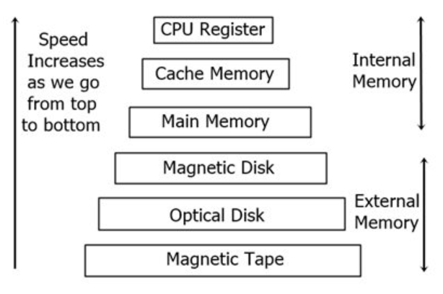
Memory Hierarchy
Storage capacity increases.
Cost per bit of storage decreases.
The CPU's memory access frequency decreases.
The CPU's access time increases.

Slide 44
Memory hierarchy
Although the main/auxiliary memory distinction is broadly useful, memory organization in a computer forms a hierarchy of levels, arranged from very small, fast, and expensive registers in the CPU to small, fast cache memory; larger DRAM; very large hard disks; and slow and inexpensive nonvolatile backup storage. Memory usage by modern computer operating systems spans these levels with virtual memory, a system that provides programs with large address spaces (addressable memory), which may exceed the actual RAM in the computer. Virtual memory gives each program a portion of main memory and stores the rest of its code and data on a hard disk, automatically copying blocks of addresses to and from main memory as needed. The speed of modern hard disks together with the same locality of reference property that lets caches work well makes virtual memory feasible.

Slide 45
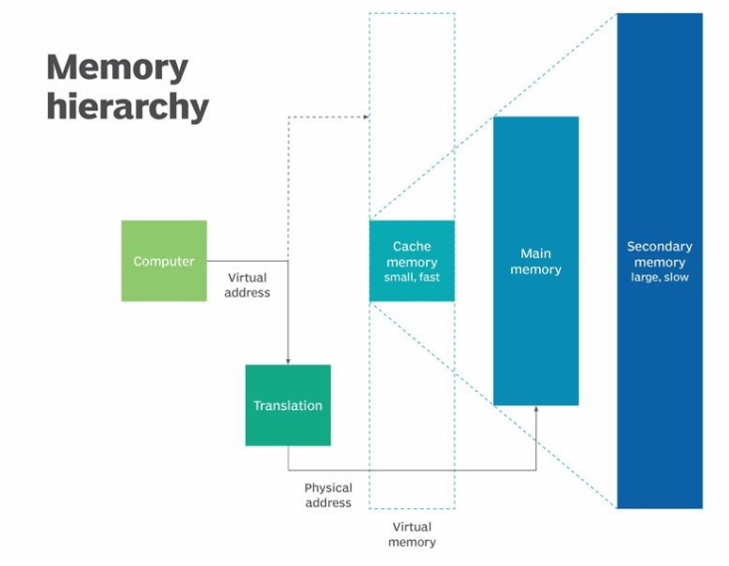
Memory hierarchy

Slide 46
Sequential Access Memory
When using sequential access, the computer needs to start its search for the required piece of data at the very beginning of the memory address and work its way backwards until it locates it.
Memory devices that allow access in this manner are referred to as sequential access memories or serial access memories, respectively.
A type of memory known as serial access memory is represented by magnetic tape.

